Slide 1
Stern data bootcamp Session 11
2022-04-20

Slide 2
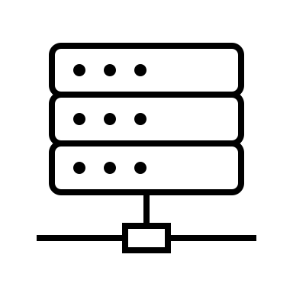





Servers have two jobs
1. Make connections
2. Do stuff with data
To databases
To end devices
Process it
Send it
To other servers
Store it in a database

Slide 3
Servers are just computers
Called a server
Optimized for connecting to other computers and processing
…on a server OS (e.g., Windows Server, MacOS server)…
Compute power…
Called a computer
Optimized for UI/UX, application usage, etc
…on a computer OS (e.g., Windows, MacOS, Linux)…

Slide 4
There is no fundamental reason why one can’t behave as the other
Now it’s a server
Install server software on this

Slide 5





Server software listens and responds
Yes
Listen constantly for a connection
Do I accept the connection?
Do stuff ordered by the connection
Connection received
No
Error (e.g., “503 unavailable”)
Success (status 200) and any data requested
Some device

Slide 6
Your computer is already connected to the internet, so making it a server just means creating listener software
Yes
Listen constantly for a connection
Do I accept the connection?
Do stuff ordered by the connection
Connection received
No
Error (e.g., “503 unavailable”)
Success (status 200) and any data requested
Some device

Slide 7

We will use a python module called Flask to do this
Yes
Listen constantly for a connection
Do I accept the connection?
Do stuff ordered by the connection
Connection received
No
Error (e.g., “503 unavailable”)
Success (status 200) and any data requested
Some device

Slide 8


A flask app is just a bunch of URLs you create that are associated with code
Your app
Your app’s “endpoints”
”Forecast” endpoint
whatever.com/forecast
Code: load SARIMAX model, forecast with user data, send back results
”Upload” endpoint
whatever.com/upload
Code: insert whatever data the user sent into the database
Hosted on some domain (e.g., “whatever.com”)
”Distribute” endpoint
whatever.com/distribute
Code: load raw data, put it in a csv, send it to the emails provided

